Slide 1
. . .

Slide 2
In Seeking to Excel…

Slide 3
Put God in Every Part of Your Life!
(not just first on your list)
Rev 1:8

Slide 4
Revelation 1:8
⁸ “I am the Alpha and the Omega,” says the Lord God, “the one who is, who was, and who is to come, the Almighty.”
God is First, Last, and Everything in between!

Slide 5
Colossians 3:12-17
Therefore, as God’s chosen ones, holy and dearly loved, put on compassion, kindness, humility, gentleness, and patience, ¹³ bearing with one another and forgiving one another if anyone has a grievance against another. Just as the Lord has forgiven you, so you are also to forgive.¹⁴ Above all, put on love, which is the perfect bond of unity.

Slide 6
Colossians 3:12-17
¹⁵ And let the peace of Christ, to which you were also called in one body, rule your hearts. And be thankful. ¹⁶ Let the word of Christ dwell richly among you, in all wisdom teaching and admonishing one another through psalms, hymns, and spiritual songs, singing to God with gratitude in your hearts.

Slide 7
Colossians 3:12-17
¹⁷ And whatever you do, in word or in deed, do everything in the name of the Lord Jesus, giving thanks to God the Father through him.

Slide 8
1 Peter 5:6-7
⁶ Humble yourselves, therefore, under the mighty hand of God, so that he may exalt you at the proper time, ⁷ casting ALL your cares on him, because he cares about you.

Slide 9
Mark 12:28-30
²⁸ One of the scribes approached. When he heard them debating and saw that Jesus answered them well, he asked him, “Which command is the most important of all?” ²⁹ Jesus answered, “The most important is Listen, Israel! The Lord our God, the Lord is one. ³⁰ Love the Lord your God with all your heart, with all your soul, with all your mind, and with all your strength.

Slide 10



What does Putting God in Everywhere look like day to day?
Practical application

Slide 11
Putting God in our Health
Spiritual (El Shaddai)
Colossians 3:2-3 –Set your mind on things above…
Physical (Jehovah Rapha)
1 Corinthians 6:19-20 – You were bought with a price… Glorify god in you body

Slide 12
Putting God in our Health
Mental/Emotional (Yahweh Shalom)
2 Corinthians 1:3 –God of ALL Comfort… we may be able to comfort…
1 Corinthians 10:13-God has promised protection for Christians up to our limits.

Slide 13
Putting God in our Personal Development
Education/Career (El De’ot)
Psalm 119:105
Your word is a lamp for my feet and a light on my path.

Slide 14
Putting God in our Personal Development
Finances (Yahweh Yireh)
God abundantly provides for His purpose and glory.
Jesus’ earthly family and ministry. (Matt 2:11)
Patriarchs made to be very wealthy. (Gen 26:12-14)
Financial prosperity is a byproduct of seeking God and following His wisdom. It’s never the goal.

Slide 15
Matthew 6:25-33
²⁵ “Therefore I tell you: Don’t worry about your life, what you will eat or what you will drink; or about your body, what you will wear. Isn’t life more than food and the body more than clothing? ²⁶ Consider the birds of the sky: They don’t sow or reap or gather into barns, yet your heavenly Father feeds them. Aren’t you worth more than they?

Slide 16
Matthew 6:25-33
²⁷ Can any of you add one moment to his life span by worrying? ²⁸ And why do you worry about clothes? Observe how the wildflowers of the field grow: They don’t labor or spin thread. ²⁹ Yet I tell you that not even Solomon in all his splendor was adorned like one of these. ³⁰ If that’s how God clothes the grass of the field, which is here today and thrown into the furnace

Slide 17
Matthew 6:25-33
tomorrow, won’t he do much more for you—you of little faith? ³¹ So don’t worry, saying, ‘What will we eat?’ or ‘What will we drink?’ or ‘What will we wear?’ ³² For the Gentiles eagerly seek all these things, and your heavenly Father knows that you need them. ³³ But seek first the kingdom of God and his righteousness, and all these things will be provided for

Slide 18
Matthew 6:25-33
you. ³⁴ Therefore don’t worry about tomorrow, because tomorrow will worry about itself. Each day has enough trouble of its own.

Slide 19
Putting God in our Relationships
Spouse/Dating (Immanuel)
Marriage & Children (Abba)
Brethren in Christ (Jehovah Rohi)
Friends (El Roi)

Slide 20
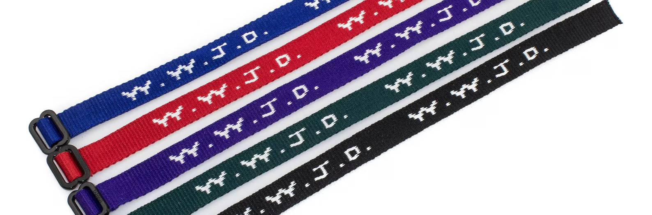
W.W.G.G. (What Would Glorify God?)

Slide 21
Fail to Excel in Putting God Everywhere & in Everything in Your Life…

Slide 22
Satan will find and devour you

Slide 23
1 Peter 5:8
⁸ Be sober-minded, be alert. Your adversary the devil is prowling around like a roaring lion, looking for anyone he can devour.
Who is it that Satan can devour???

Slide 24
Satan very cleverly uses the same things we’ve discussed as idolatrous replacements of God in our lives.
I call them Inconspicuous Idols

Slide 25
Idol defined:
Objects, people, or even ideologies that are not God but are worshiped as if they were God and/or replace your dependence on God in anything and everything.

Slide 26
Inconspicuous Idols
Important note: “Inconspicuous Idols” are not necessarily, in and of themselves, idolatrous like the baals, asherahs, or molechs of ancient times or the buddhas or shivas of today.

Slide 27
Beware Inconspicuous Idols! (Potential Examples)
Good deeds
Good Physical Health
Depression
Money
Authority/credentials
Spouse
Friends
Local church/preacher

Slide 28

If ever there is something or someone that replaces your dependence on God, you are slipping into this form of idolatry.

Slide 29
1 Peter 5:9-11
⁸ Be sober-minded, be alert. Your adversary the devil is prowling around like a roaring lion, looking for anyone he can devour. ⁹ Resist him, firm in the faith, knowing that the same kind of sufferings are being experienced by your fellow believers throughout the world.¹⁰ The God of all grace, who called you to his eternal glory in Christ, will himself restore, establish, strengthen, and support you after you have suffered a little while. ¹¹ To him be dominion forever. Amen.

Slide 30
. . .

